Slide 1
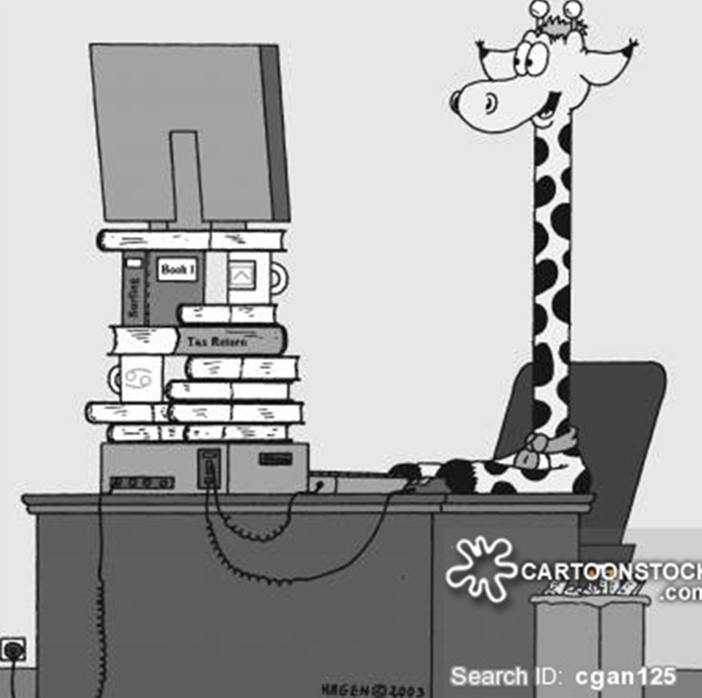
Ergonomics for Remote Workers
Melissa A. Claar, MPH, ATC, CLE, CEAS III
Senior Safety Specialist
UK Environmental Health & Safety

Slide 2
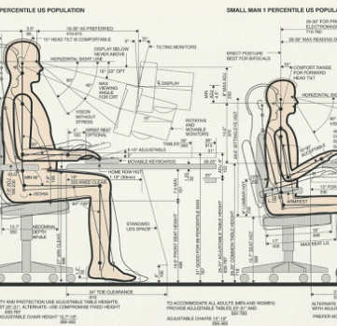
Ergo What?
Ergonomics is the study of the relationship between people and their working environment, especially the equipment they use.
Ergonomics allows designing or redesigning tasks to fit the worker

Slide 3
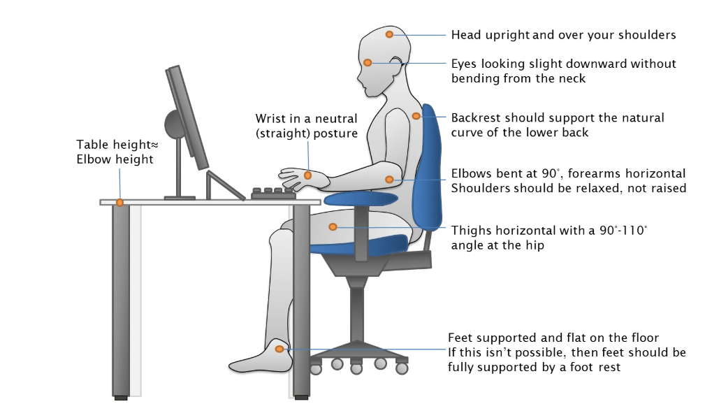
What is Good Posture?

Slide 4
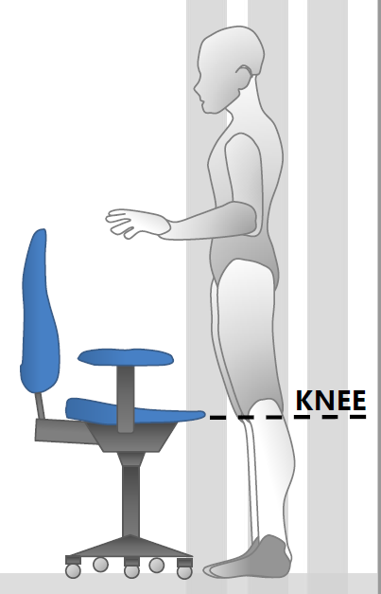
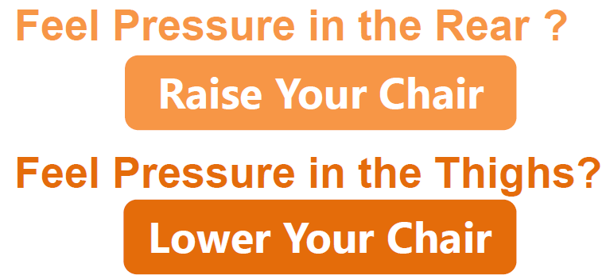
Ergonomic Chair and Fitting
Chair Fitting
Qualities of an Ergonomic Chair
Breathable Fabric
Five-Prong Base
Adjustable Armrests
Adjustable Seat Pan
Adjustable Seat Height
Adjustable Lumbar Support
While standing, adjust the height of the chair so that the highest point of the seat pan is just below your kneecap.
Even Weight Distribution is the Goal!

Slide 5
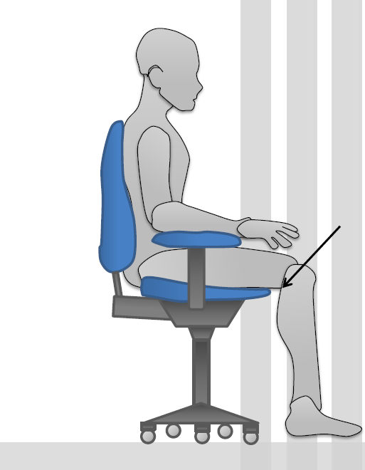
Chair Fitting Continued…
Seat Depth
When sitting, the seat pan should allow you to use the back support without the front of the seat pressing against the back of your knees.
Two Fingers Gap Space Between Seat Edge and Back of the Knee
If you cannot sit back in your chair with 2 fingers gap, it may be helpful to use a pillow during remote work

Slide 6
Find your best workstation at home while using household items
Technology
Tablet
Laptop
Keyboard
Mouse
Monitor
Room
Dining Room
Kitchen
Living Room
Office
Bedroom
Household Items
Table/Desk
Chair/Stool
Pillows/Towels
Boxes
Cutting/Ironing Board

Slide 7
Find Your Best Workspace
Primary Workstation
Use separate keyboard, mouse, & additional screen
Worksurface at elbow level
Top of screen just below eye level
Unless you have bi or trifocals – lower screen till neck is in a neutral posture and not looking up at monitor
Feet and back supported by footstool, box, or empty trash can
Minimal glare from windows
If screen brightness is too much, use Nightlight adjustment in Windows 10
If no monitor, use books or laptop stand to raise laptop
If worksurface is too high, sit on pillow(s)

Slide 8
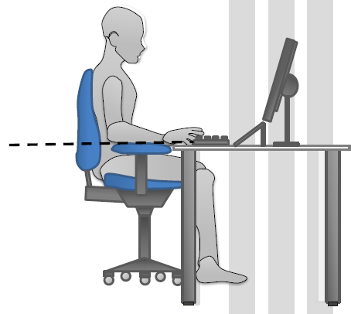
Work Surface
For the most ergonomic worksurface setup, align the tabletop to your elbow height. If you cannot reach your elbow height, consider the following:
If table is too high, shoulders will be raised and put pressure on wrists
If table is too low, back and neck will feel pressure from leaning over
Tabletop = Elbow Height
If table is below elbow height
Raise surface or adjust table with risers if possible
If table is above elbow height
Use footrest to support feet

Slide 9
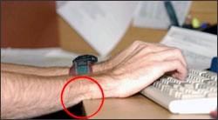
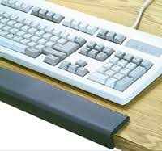
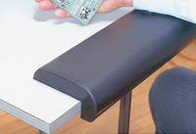
Contact with Hard Edges
External contact stress occurs when part of your body rubs against a component of the workstation, such as the chair seat pan or edge of the desk. Nerves may be irritated, or blood vessels constricted as a result.
Reduce contact stress by using the following on edges:
Soft fabric cloth
Pool noodles
Sit closer and not rest on desk edge

Slide 10
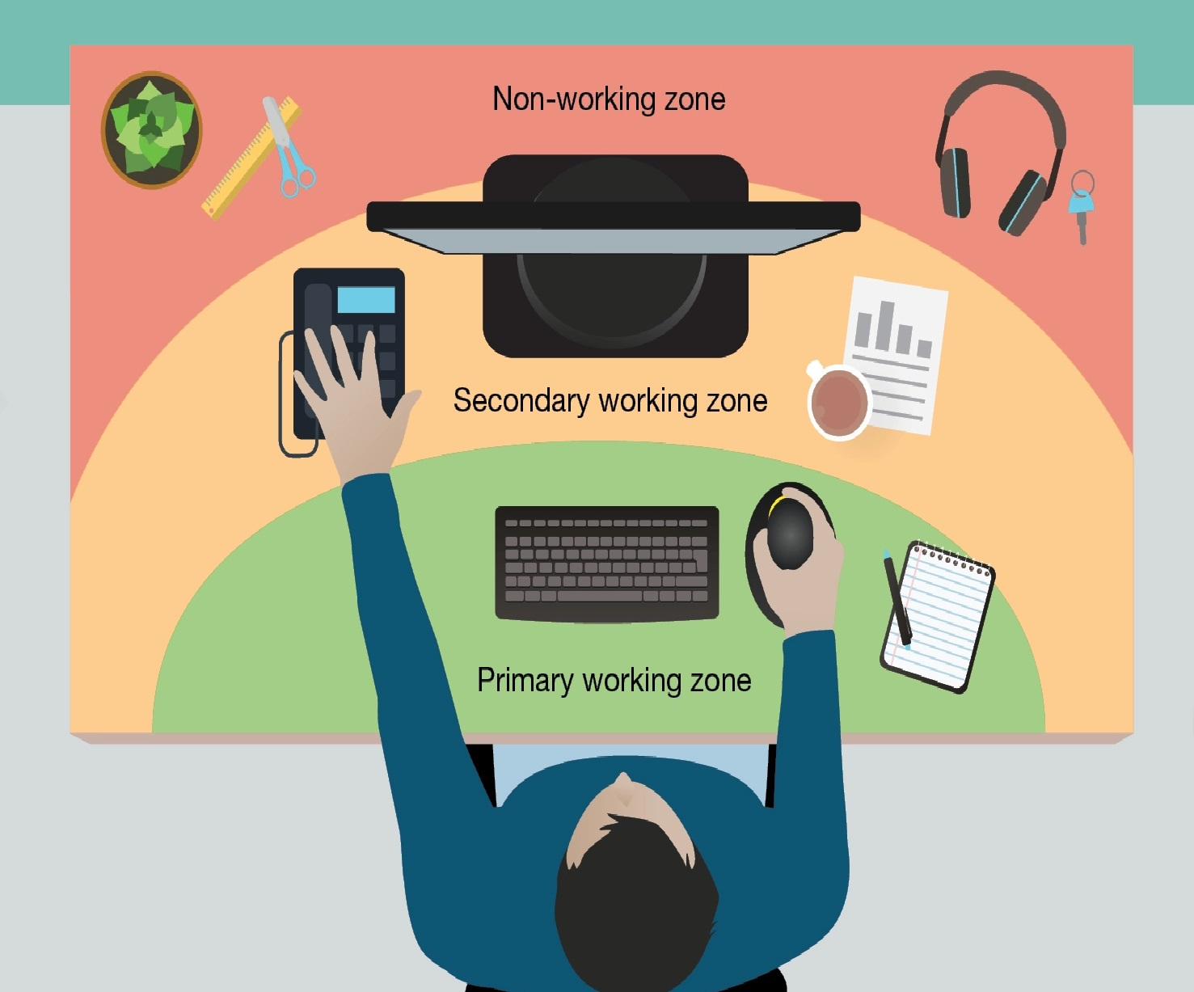
Working Zones
Limit reaching and static postures by putting frequently used items like your mouse & keyboard in the primary working zone. Secondary working zone should include items you reach for less frequently like your monitor and phone. The non-working zone should have items that you infrequently need during the workday.

Slide 11
Why is it uncomfortable to work on a laptop for extended amounts of time?
Laptops were designed with portability in mind. A fixed screen and keyboard limits adjustability for the user. Sharp edges can add strain to wrists and can possibly hinder circulation. This makes it difficult to maintain a proper typing position for the arms, wrists, and hands. In effect, the user ultimately adjusts to the compact workstation, rather than the workstation having adjustments for the user.

Slide 12
When using a laptop at home remember to….
Use an external full-size keyboard and mouse whenever possible and maintain about an arm’s length viewing distance from the monitor.
When seated your hips should be slightly higher than your knees.
When looking down at the screen, be careful not to bend your neck and head forward to view monitor(s). Try tucking in your chin to look down, keeping your head and neck balanced over the shoulder and spine.
Position elbows at the torso’s side with approximately 90 degrees bend with arms relaxed and resting on chair’s armrest when possible.
Avoid resting hand/wrist on the wrist rest areas on the laptop while typing. Try using whole hand and arm movements to navigate around the keys.

Slide 13
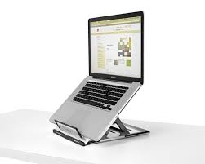
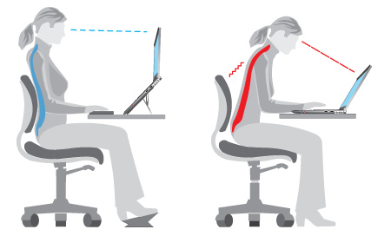
When using a laptop at home remember to….
If you are seated at a chair or couch, use a pillow to support your arms while keying or if your seat is too deep, try adding a pillow for back support.
Take mini breaks every 20 to 30 minutes. Stand up and stretch. If you feel any strains or pains, stop what you are doing and experiment with different positions.
Use laptop stand with external keyboard & mouse
Ergonomic postures while using laptop stand

Slide 14
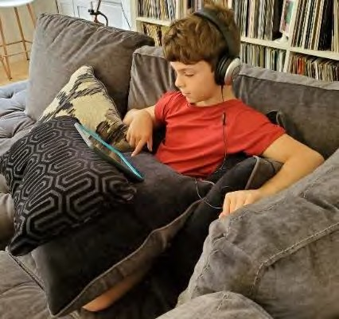
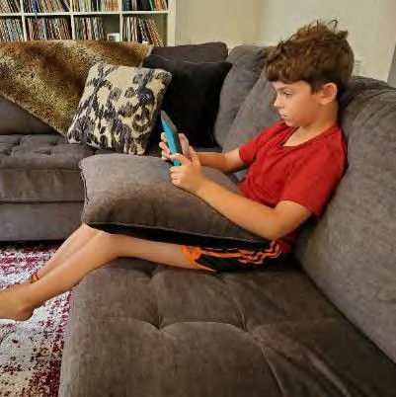
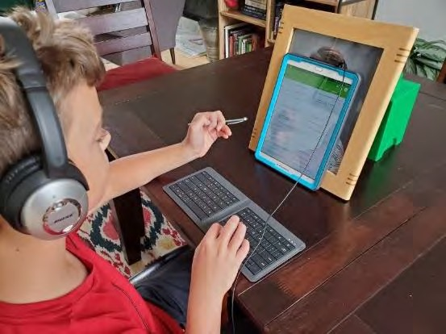
When Using a Tablet
Prop it up for handsfree use
Use a cookbook or photo frame as a prop
Try using a stylus with the tablet
Use a Bluetooth keyboard if available
If no stand, use pillow to support arms

Slide 15
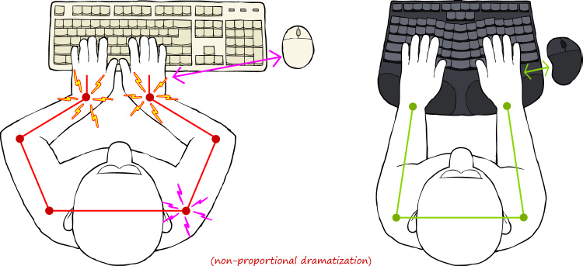
Ergonomic Keyboard & Mouse Use
When using a keyboard and mouse, keep the mouse close to keyboard to limit reaching out for the mouse.
Having an ergonomic keyboard will assist in limiting awkward postures at the wrist and elbows and help keep wrist in neutral posture.

Slide 16
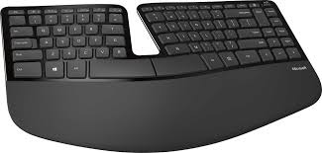
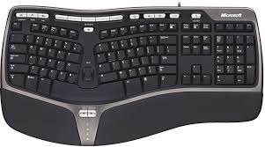
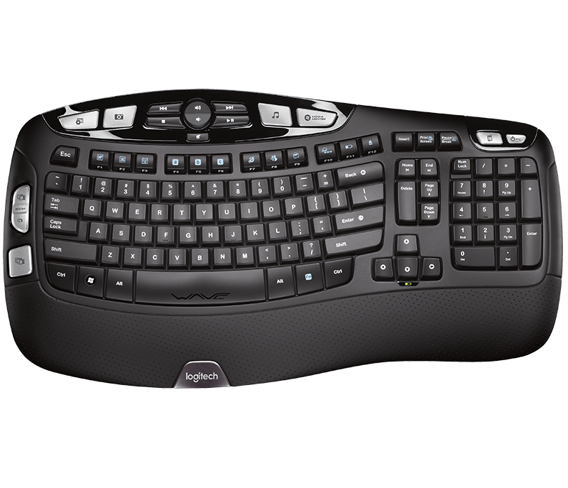
Ergonomic Keyboards
Ergonomic keyboards benefits depends on the user and the type of work
Ergonomic keyboards promote neutral wrist posture, but research does not provide conclusive evidence that they reduce the risk of injury

Slide 17
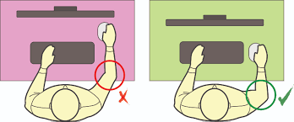
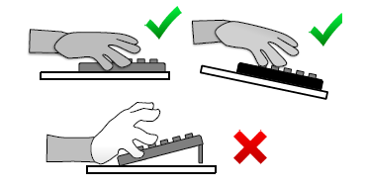
Keyboard & Mouse Placement
Ensure mouse & keyboard are on the same work surface
Move mouse from the shoulder and not the wrist!
Keep mouse as close as possible to reduce movement
Place keyboard flat or negative tilt

Slide 18
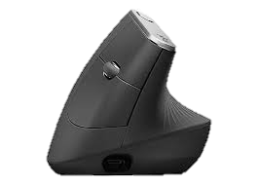
Mouse Size & Styles
Find an appropriate mouse that fits your hand’s width and length.
Types of Ergonomic Mice
Trackball
Vertical
When the mouse is too small, over-gripping could occur
When the mouse is too large, pinch grip could occur

Slide 19
Use Quick Keys When Possible

Slide 20
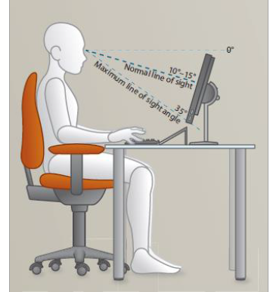
Monitor Placement
Distance – Arm’s length away
Height – Top of monitor will be in a straight line with your eyes
Location – Directly in front of you

Slide 21
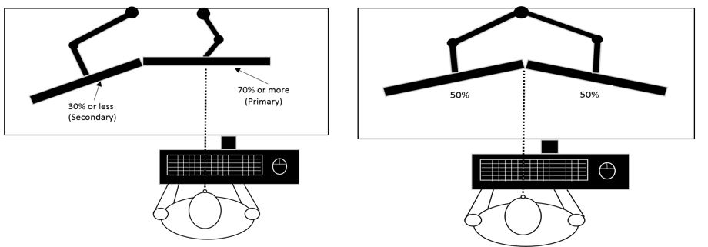
Maximize Screen Space
When using one monitor as the primary monitor.
When using both monitors equally

Slide 22
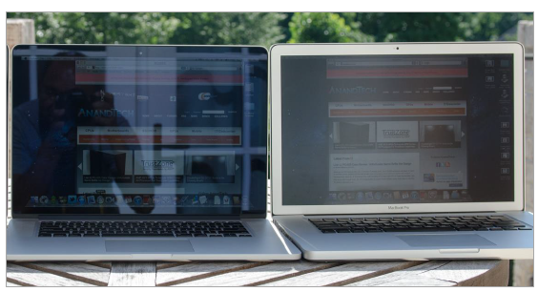
Illumination & Glare
Recommendations:
Task lighting on desktop
Shine task light on keyboard/paperwork, not the screen
Close blinds behind monitor
Set monitor at a right angle to the window
Avoid glare from:
Overhead lights
Windows behind the monitor
Windows behind the worker

Slide 23
Take Care of Your Eyes
20/20/20 Rule
Every 20 minutes, focus on something 20 feet away for 20 seconds
Take Micro Rest Breaks Every Hour
Every 30 minutes take a 2-5-minute break
Balance 2D screen time with 3D hand-work
Try crafts, art, building or making something
Try activities that require a change in focus from near to far
Frisbee/catch
Turn off screens 1-2 hours before bed

Slide 24
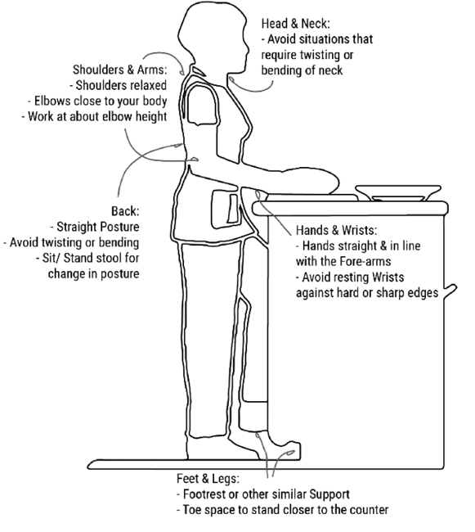
Change it up – Use the Kitchen!
Take advantage of your portable laptop & use alternative workspaces for short durations or specific tasks
Postures:
Orange line – posture is aligned to support the low back and neck
Blue line - elbow is at torso’s side at about 90 degrees
Foot is supported by footrest under counter

Slide 25
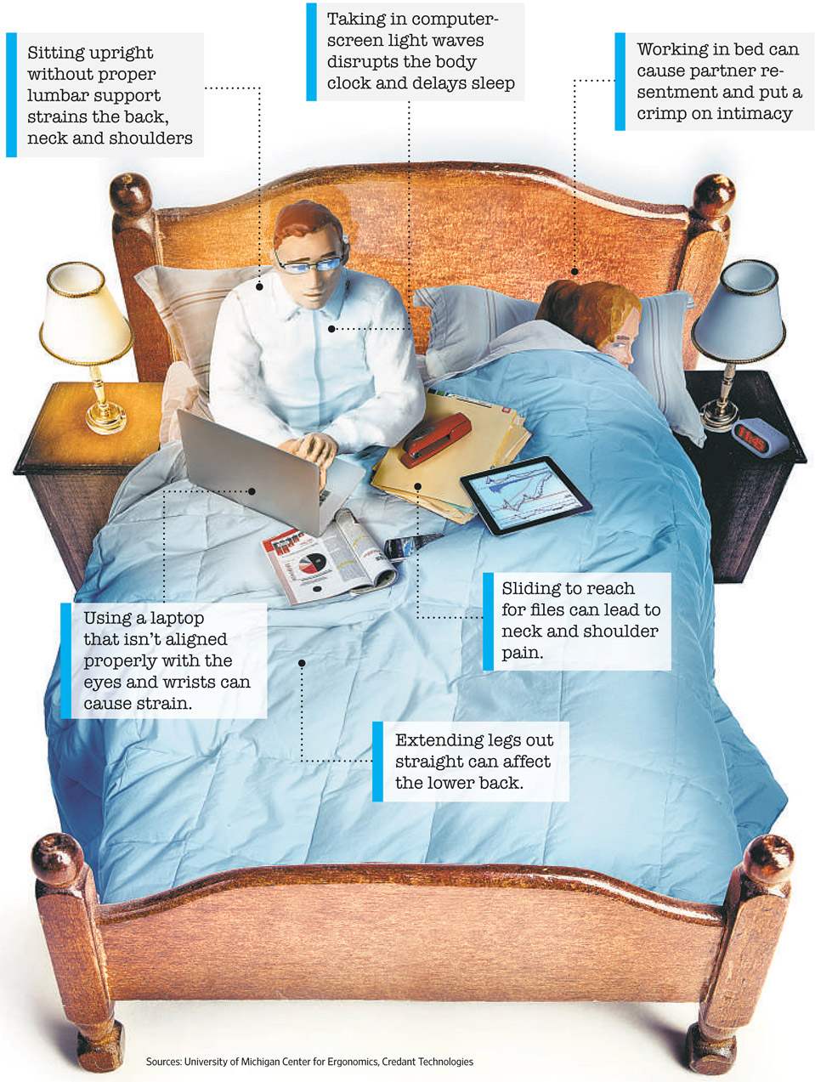
Avoid Working from Bed

Slide 26
Make Time to Move
Between Work Tasks
Utilize normal workday transitions
To and from work – take a walk during the time you would drive to work and then again when going home
Up/downstairs - when going to meetings, go up and down the stairs as if you were really walking to your meeting
During Work
Stationary stretches and exercises during meetings
Use a timer for movement break reminders (every 30 minutes)
Move More
Get regular exercise
Try using UK Wellness or YouTube for workouts (yoga, stretching, etc.)

Slide 27
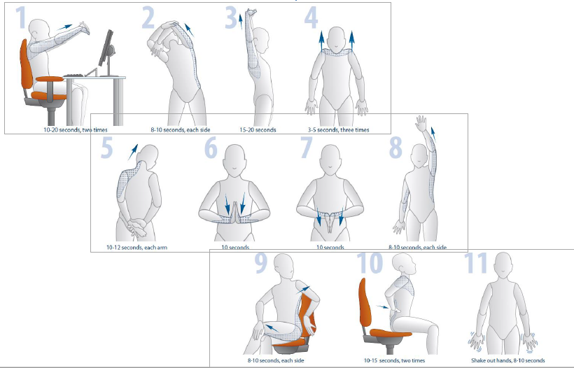
Stretches
Note: If you have had any recent health problems, injury, or surgery, or if any of these actions cause you any pain, consult a health professional before starting this program

Slide 28
Keep a Routine & Schedule
Maintain a work/life balance by creating boundaries and making a routine for work and personal time
Shower and get dressed for work
Plan a home-to-work commute (transition time into working)
Plan time for exercises – get outside when possible
Maintain standard meal and snack times
Shut down computer at the end of the workday
Set realistic expectations!

Slide 29
Keep a Routine & Schedule

Slide 30
Resources
Suggested ergonomic hardware like ergonomic keyboards, mice, footstools can be found on UK EHS webpage: https://ehs.uky.edu/ohs/off_lab_ergo.php
EHS is offering ergonomic assessments of home workstations via:
Zoom meetings – schedule with Melissa Claar by email - melissa.claar@uky.edu
Email – send pictures of your home workstation to Melissa Claar at melissa.claar@uky.edu for recommendations
Note: Modified presentations from Melissa Afterman at UC Berkeley & Learn Ergo and UC Davis

